Slide 1
Australia Business Week in India
12-16 January 2015
Australia’s Leading Development Stage Uranium Company
Notes:
… a bit more on yourself, even though an introduction has been made.
Thank whomever for the opportunity to present and recognise the other peers presenting with some sort of statement.
[click to next slide]

Slide 2
The Australia-India Opportunity
    September 2014 - Australia / India signed a MoU for “Cooperation in the Peaceful Uses of Nuclear Energy”
    Includes the Australia – India Nuclear Cooperation Agreement
    Framework for greater cooperation on a broad range of nuclear-related areas:
      Safety
      Regulatory and technological advances in the nuclear fuel cycle
      Upstream and downstream skills exchange
    Administrative agreements to detail specific terms of cooperation
    Creates the opportunity for direct investment by Indian firms to help develop Australian uranium mines
    Long term security of uranium concentrate supply
2

Slide 3
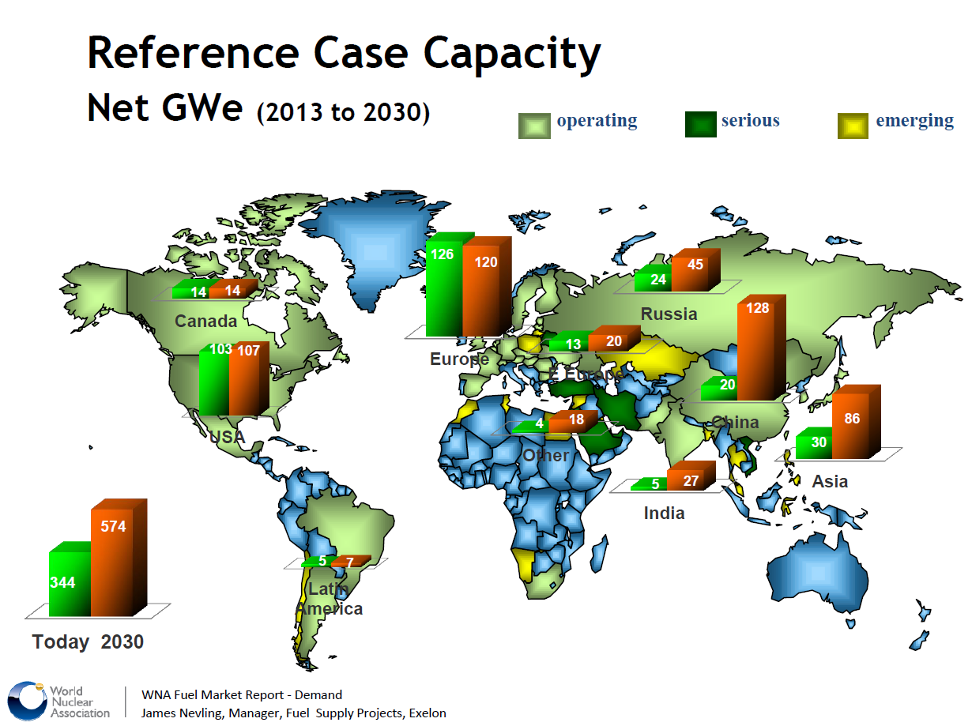
Increasing International Demand
    437 operable reactors today require ~78kt of U3O8
    70 reactors under construction
    Reactor demand for raw materials is set to double in the next 15 years
Australian Trade Agreements include: Japan, China, Russia, Middle East and soon India
3
Notes:
“Looking at the numbers, not the current market sentiment, strongly supports a mid term uranium market recovery”
“The growth in nuclear reactor builds is more now than pre Fukushima when the LT contracting price was USD$75” (the difference however being the current Japanese reactors being off-line)
“This growth is being driven by the new markets of China, India and the Middle East and existing markets ” (Maybe a bit more on India.)
Australia has trade agreements supporting uranium sales to these growth areas and with those countries supporting this growth including Japan and Korea.”
[click to next slide]

Slide 4
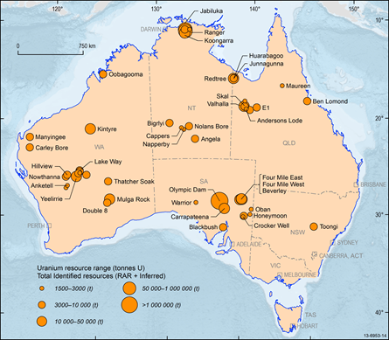
Australian Uranium Facts
1st in resources
Australia has 34 per cent of global uranium resources
- the largest in the world.
2nd largest primary energy source
22 per cent of Australia’s total domestic plus export primary energy production in 2012-13.
3rd in production
Australia is the world’s 3rd biggest producer. It produced 11 per cent of global supply in 2013.
4,200 jobs
Uranium industry employment, much in remote areas
5,710 tonnes
Australia’s production of uranium in 2013-14
8,900 tonnes
Bureau of Resources and Energy Economics forecast Australian uranium production in 2018-19.
$622 million up to $1.1 billion
Australian uranium export earnings in 2013-14.
Bureau of Resources and Energy Economics forecast value of Australia’s uranium exports in 2018-19.
Australian uranium resources
4
Notes:
“Looking at the numbers, not the current market sentiment, strongly supports a mid term uranium market recovery”
“The growth in nuclear reactor builds is more now than pre Fukushima when the LT contracting price was USD$75” (the difference however being the current Japanese reactors being off-line)
“This growth is being driven by the new markets of China, India and the Middle East and existing markets ” (Maybe a bit more on India.)
Australia has trade agreements supporting uranium sales to these growth areas and with those countries supporting this growth including Japan and Korea.”
[click to next slide]

Slide 5
Australian Uranium Development Projects
Project | Owner | State | Status * | Earliest production
Ranger 3 Deeps | ERA | NT | Permitting ongoing | 2015+
Wiluna | Toro Energy | WA | 2 mines and processing plant location permitted Final technical studies | 2017
Mulga Rocks | Vimy Resources | WA | Permitting ongoing | 2017+
Westmoreland | Laramide | Qld | Permitting ongoing | 2018+
Kintyre | Cameco | WA | Permitted, care and maintenance | 2018+
Manyingee | Paladin | WA | On hold | 2020
Yeelirrie | Cameco | WA | Permitting | 2020+
Olympic Dam expansion | BHPB | SA | By-product uranium production Investigating less capital intensive design | N/A
* Permitting refers to Australian State and Federal government environmental approvals
5

Slide 6
Toro Corporate
 | ‘M
Total shares on issue⁽¹⁾ | 1,903.8
Market capitalization at 8cps | $152.2
Cash on hand⁽²⁾ _{(31 December 2014)} | $25.2
Investments and receivables in Strateco Resources | $18.9
Debt owing to MBL, March 2016 | $12.0
Major shareholders⁽³⁾
A further 59.1M Deferred Consideration Shares are due to be issued to Sentient to complete the acquisition of Sentients Uranium Interests and a further 32.2M Deferred Subscription Shares are to be issued to Sentient as consideration for a further $2.5M in cash to Toro. Refer ASX announcement dated 3 November 2014 for further details
Unaudited and ex the $2.5M referred to in (1) above
Upon the issue of the shares to Sentient in (1) above, Sentient’s interest in Toro is expected to increase to 18.3%,
6

Slide 7
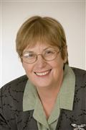
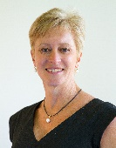
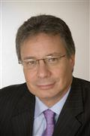

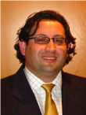

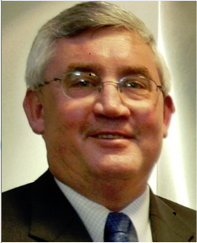
Toro Board
Erica Smyth (Non-Executive Chairman) | 30+ years experience in the mineral and petroleum industries Director of Australian Nuclear Science and Technology Organization
Dr Vanessa Guthrie (Managing Director) | PhD in Geology, Environment Extensive executive & management experience in sustainability, environment, government & approvals, mine operations, community & indigenous in Western Australia
Greg Hall (Non-Executive Director) | Mining engineer & founding director of Toro 30+ years resource sector experience, including 21 years managing Ranger, Jabiluka & Olympic Dam and uranium marketing with Rio Tinto
Richard Patricio (Non-Executive Director) | Executive Vice President Corporate Affairs of Mega Uranium Lawyer qualified to practice in the Province of Ontario
Richard Homsany (Non-Executive Director) | Executive Vice President, Australia or Mega Uranium Extensive experience in the resources industry, including working for North Ltd., which was acquired by Rio Tinto Ltd. in 2001, and board experience with publicly listed resource companies in Australia
Michel Marier (Non-Executive Director) | Mfin, CFA Nominee of, and current investment manager with, Sentient Investment banker, 5 years with Sentient, 8 years with CDPQ in Montreal
John Cahill (Non-Executive Director) | Bbus, Fellow of CPA Finance and operations executive in the energy utility sector, past CEO of Alinta Infrastructure Holdings and CFO of Alinta Limited Appointed January 2015 Chairman of Audit and Risk Management Committee, current director of ASX listed Emeco Holdings Limited

Slide 8

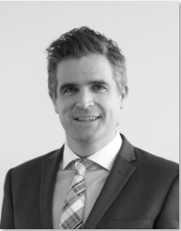
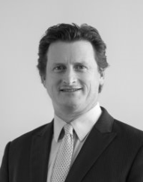
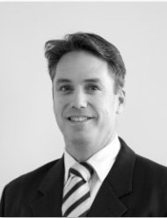

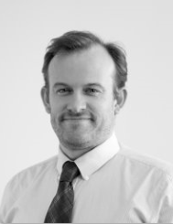
Toro Leadership Team
Vanessa Guthrie | Managing Director PhD in Geology, Environment Extensive executive & management experience in sustainability, environment, government & approvals, mine operations, community & indigenous in Western Australia
Todd Alder | Chief Financial Officer | Company Secretary 16+ years financial management experience within the Mining, Energy and Steel Manufacturing industries
Andrew Worland | General Manager – Wiluna and Project Development ~20 years corporate, project financing, product marketing experience in development and operations stage mining companies. Bulk, base, strategic and precious metals
John Baines | Processing Manager 17 years of experience in a range of operational and process design roles. He specialises in uranium processing and has worked for BHPB, WMC and as a general consultant to the industry
Richard Yeeles | Approvals and Community Director - Wiluna Extensive management experience in government/ community relations, ex-BHPB Olympic Dam Expansion, WMC, Government
Greg Shirtliff | Geology Manager PhD from Australian National University 13 years experience in geology and geochemistry of uranium including a PhD. Employed in roles within the environment, mining and exploration side of the uranium mining industry with ERA-Rio Tinto and Cameco prior to joining Toro Energy
8

Slide 9
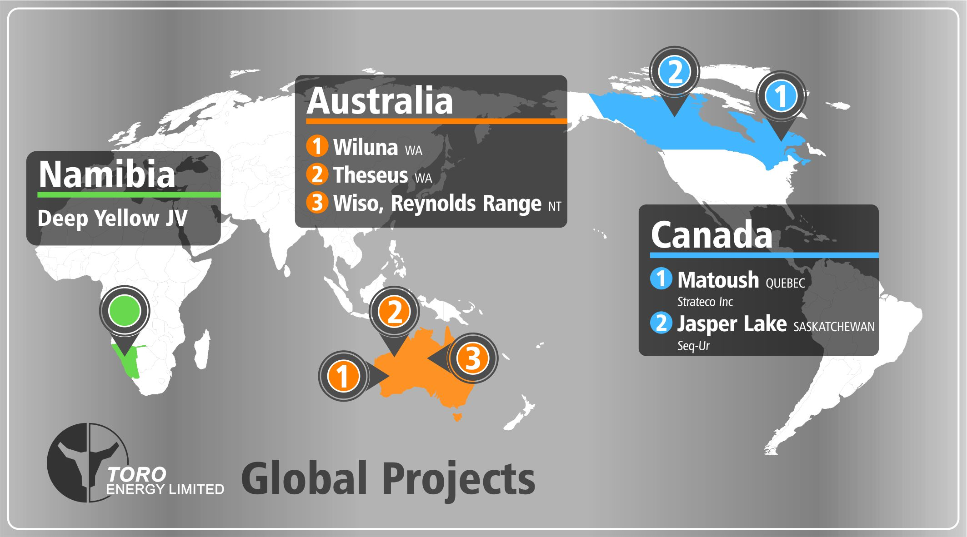
Toro Assets
9

Slide 10
Toro is committed to growing the company to being a true uranium leader
1
Unlocking the potential
of Wiluna uranium province
Company Growth
Capable of production to meet market recovery and new demand post 2020
Competitive cost profile
Exploration
High quality, highly prospective exploration assets
Resource scale (pounds and grade for contained metal)
Acceptable jurisdictions with understood permitting process
Low counterparty execution risk
Wiluna Project optimisation, R&D and cost improvement
Financing a central processing facility to treat regional deposits
Joint Ventures and Toro owned
Replicate the regional success achieved in Athabasca and Kazakhstan
2
3
10

Slide 11
Toro and Wiluna’s Competitive Advantage in Australia
Attribute | Explanation
Team | Executives with proven project approvals, development, financing and operations experience
Asset | The Wiluna Uranium Project
Ownership | Toro is an independent Australian company with diverse shareholders that will welcome strong overseas strategic investors
Approvals | Wiluna and Kintyre (Cameco / Mitsui joint venture) are the only Australian development stage uranium projects to have any government environmental approvals in place
Development timetable | The only project in Australia capable of immediate development
Offtake | All Wiluna mine production is available for offtake
11

Slide 12
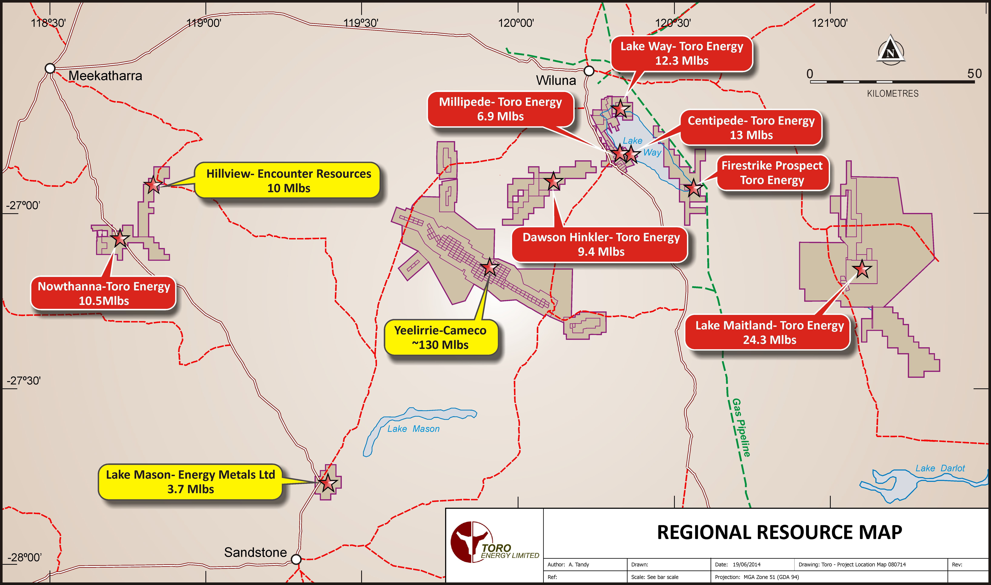
Wiluna Uranium Province
Wiluna project resources highlighted in red with JORC resource categories detailed on slide 13 and referenced in ASX release 19 November 2013
12

Slide 13
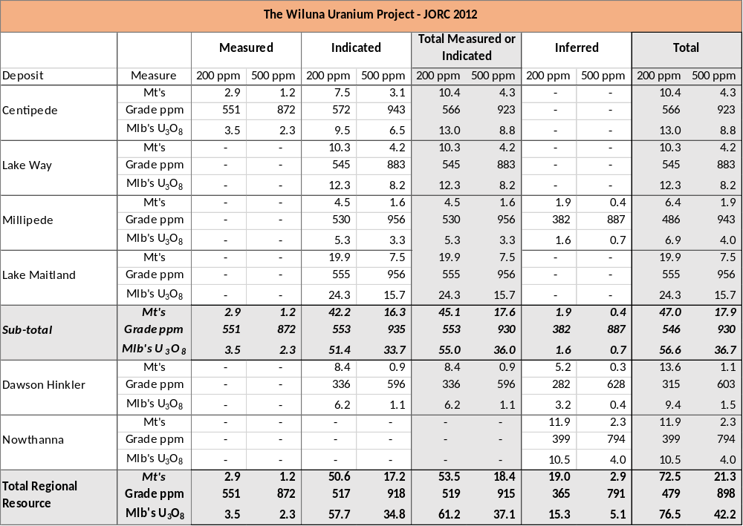
Wiluna Resources
Wiluna = a high grade, long life mine with scale
Refer to ASX release 19 November 2013 and Competent Persons statement at end of this presentation
13

Slide 14

Major Approval & Permitting Requirements
Wiluna Deposit | Government Environmental Approvals | Mining Leases Granted | Traditional Owner Agreement
Centipede |  |  | 2015
Lake Way |  | Application | 2015
Millipede | In process |  | 2015
Lake Maitland | In process |  | 2015/16
Dawson Hinkler | Post 2016 | Application | Negotiations 2016
Nowthanna | Post 2016 | Post 2016 | Negotiations 2016
CORE DEPOSITS
14
Notes:
… “The Wiluna resource is made up of 4 core deposits C, LW, M & LM and 2 potential upside deposits DH & N. Current modelling and economics includes only the 4 core deposits with mining being initiated at Centipede which has full government environmental approvals and a granted mining lease.”
“In the right price environment mining could commence at Centipede with completion of approvals and permits for the remaining deposits due well before mining requirements.”
“With regards to the right pricing environment where does Wiluna sit compared to peer development projects..?”.
[click to next slide]

Slide 15
Key Approved Project Characteristics
Area | Description
Tailings | In-pit tailings disposal within the mining void opened at Centipede and Millipede only Disposal of no more than 2.1Mtpa of tailings for entire life of Project
Rehabilitation | Progressive rehabilitation of the mining void/tailings Land would be re-contoured to blend with local terrain and revegetated using local provenance species
Annual Production | Up to 1,200 tonnes of uranium oxide concentrate per annum
Water | Up to 2.5 GL/a sourced from underground aquifer(s) Approximately 0.7 GL/a of fresh to brackish water would be sourced from the West Creek borefield Balance of water would comprise saline or hypersaline water from pit dewatering No discharge of excess water to the lake surface
Power | Up to 12 MW of on-site gas powered generation (with diesel as back-up)
Waste | Overburden to be temporarily stored adjacent to pit, then pack-filled into void.
Estimated ground disturbance | Approximately 1,530 hectares
Workforce | Construction – up to 350 Operations – up to 170
15

Slide 16
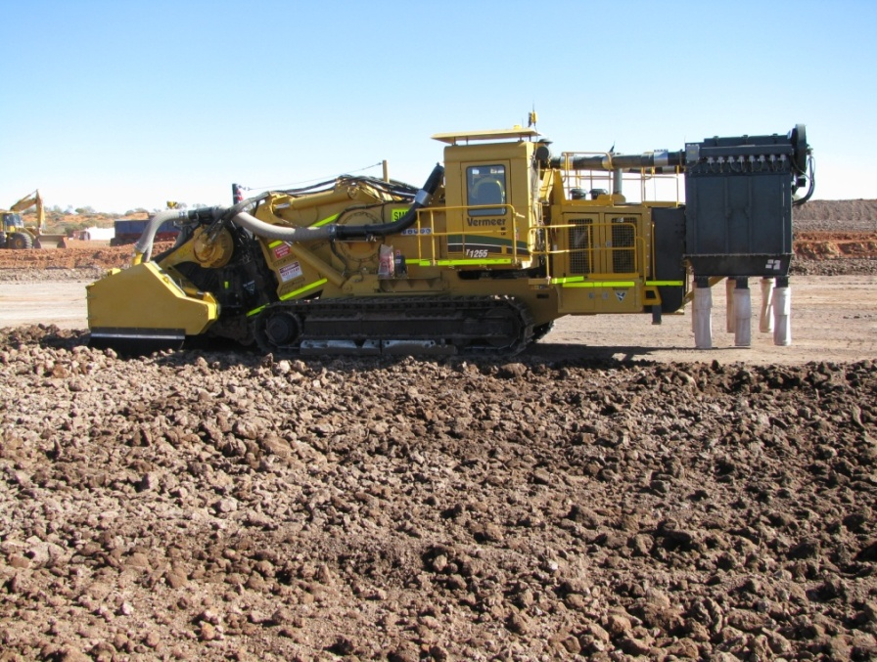
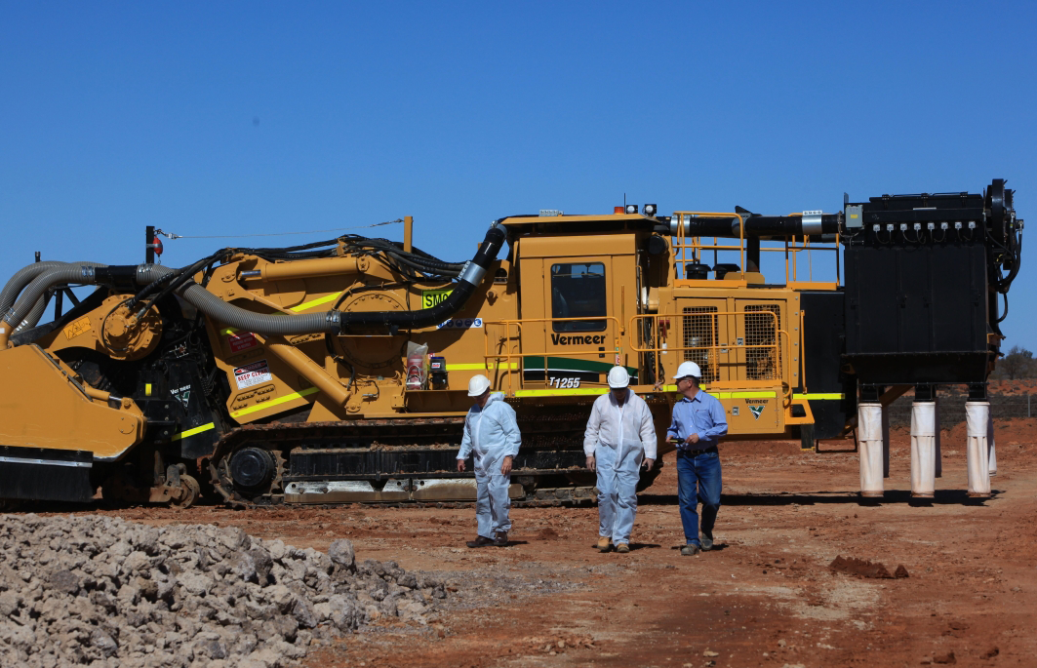
Mining Methods
Progressive mining, tailings and rehabilitation
2010 trial mining confirmed selective mining process using Vermeer continuous miner cutting 25cm bench
    Ore zone <10m deep
    No drill and blast or crushing required
    Average strip ratio = 3.7
  Groundwater control systems tested
  GPS/gamma logger for pit floor grade mapping
    Ability to map and select higher grade confirmed
  Economic mine plan includes Centipede, Millipede, Lake Maitland, Lake Way
  In pit tailings deposition, waste rock cover proposed
  Progressive rehabilitation tested using local vegetation species, landscape returned as close as possible to natural land surface level
  Recovery of 15 tonnes ore and 40 tonnes groundwater for pilot plant testwork
16

Slide 17
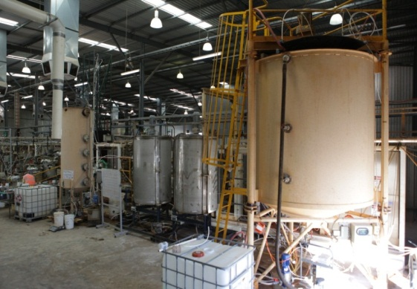
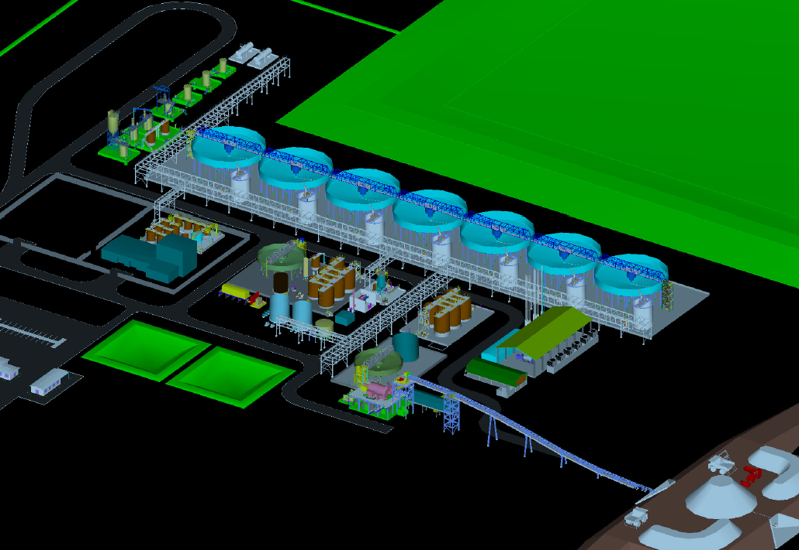
Processing Facility
  Atmospheric agitated alkaline leach process proven through 2011 pilot plant testwork
  Fully integrated continuous hydrometallurgical circuit
  Pilot scale testing of process – 0.7t per day throughput included in plant design
  Utilised 2x7 tonne ore samples and 40 tonne site groundwater
  Two types of ore tested (Calcrete and clay dominant) – robust across variations in mineralogy
  Economic processing and recovery proven (~85%)
  Hypersaline water used for processing with no loss of recovery
  Sample uranium concentrate produced
  Savings from coarser grind & lower leach temperature
  Plant layout, mass and water balance and engineering completed
  Lake Maitland ore suitable for selected process
17

Slide 18
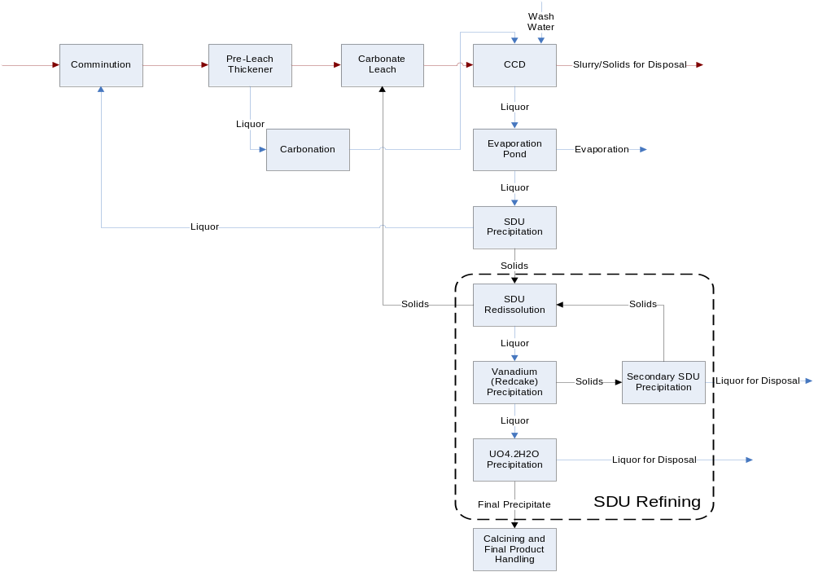
Flowsheet – Block Flow Diagram
18

Slide 19
Project Status
Area | Work completed | Confidence
Resources | Measured and Indicated JORC 2012 97% of current mine plan M&I resource | Very high
Permits | Two mines approved Processing facility and tailings disposal approved Millipede and Lake Maitland referred to government | Very high
Mining | Scoping study / pre-feasibility study completed Independent consultants | High
Metallurgy and Plant Design | Definitive feasibility study completed Independent consultants Process Flowsheet optimisation underway | High
Infrastructure | Scoping study / pre-feasibility study completed | High
Capital cost estimate | Preliminary Economic Assessment completed +/- 25% | Good
Operating cost estimate | Preliminary Economic Assessment completed +/- 25% | Good
19

Slide 20
Work Program to Final Investment Decision
Area | Work Outstanding | Comment
Reserves | Complete Ore Reserve calculation | Limited further drilling required In conjunction with feasibility study
Approvals | Submit Mining Proposal Finalise Millipede and Lake Maitland approvals process Traditional Owner agreements | In hand, to be initiated consistent with production timetable
Feasibility Study | Value engineering studies underway Complete final feasibility study and construction planning | 6 – 9 months to complete Commence when project partner in hand
Financing | Secure major project partner Secure offtake and marketing agreements | Focus area

Slide 21

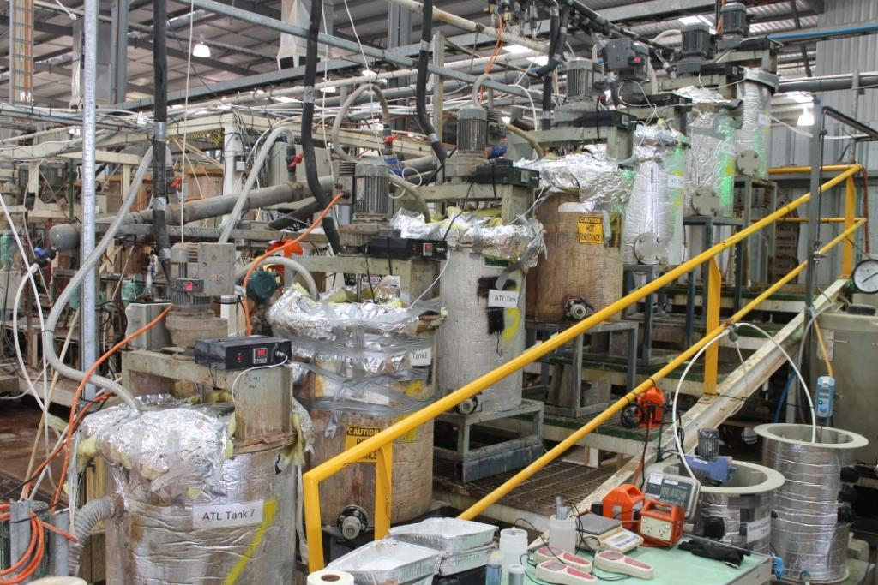
Wiluna Project Financing Concept
Project Finance Structure
Strategic Partner
: Equity
: Offtake agreement
Joint Venture
Wiluna Project Finance Target $315m
Toro is willing to sell a significant interest in the Wiluna Uranium Project
Toro expects the project will support $160M of debt with offtake agreements from its partner
21
Notes:
The Wiluna project is the most advanced uranium project in Australia
one of only two Australian projects to receive State environmental approval in last seven years
Toro has worked hard to bring project to market
Awaiting final Federal Government decision
Mining process proven
Processing technique proven
Excellent relationship with local people
Engaging with several potential finance partners
Wiluna targeted to be the next new uranium mine in Australia
Subject to approval and financing – commitment in latter 2013
First production and sales during 2015
JV - Japan
Korea
Chine
India

Slide 22
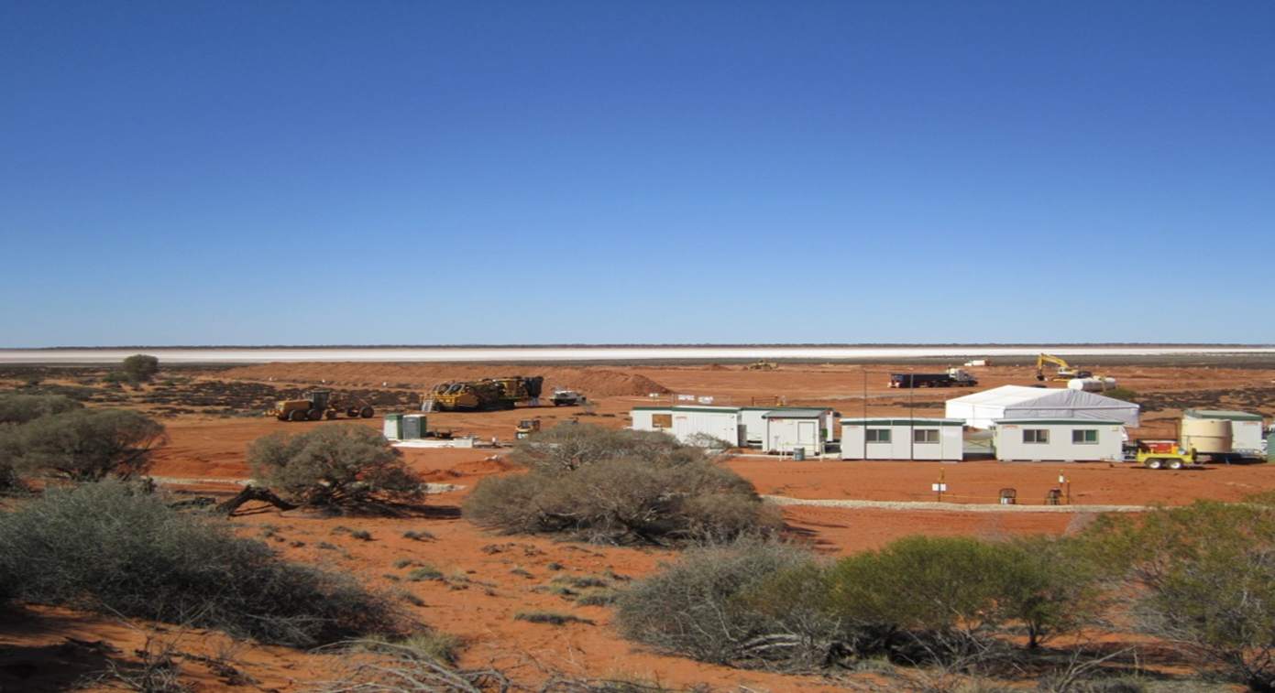
Contact
Dr Vanessa Guthrie Andrew Worland
Managing Director General Manager
L3 33 Richardson St
WEST PERTH WA 6005 Email: info@toroenergy.com.au
Telephone: +61 8 9214 2100 Website: www.toroenergy.com.au
22

Slide 23
Competent Persons Statement
Wiluna Project Mineral Resources – 2012 JORC code compliant resource estimates – Centipede, Millipede, Lake Way, Lake Maitland, Dawson Hinkler and Nowthanna deposits
The information presented here that relates to Mineral Resources of the Centipede, Millipede, Lake Way, Lake Maitland, Dawson Hinkler, and Nowthanna deposits is based on information compiled by Dr Greg Shirtliff of Toro Energy Limited (with the aid of Mega Uranium Limited geologists Mr Stewart Parker and Mr Robin Cox in the case of Lake Maitland) and Mr Robin Simpson and Mr Daniel Guibal of SRK Consulting (Australasia) Pty Ltd. Mr Guibal takes overall responsibility for the Resource Estimate, and Dr Shirtliff takes responsibility for the integrity of the data supplied for the estimation. Dr Shirtliff is a Member of the Australasian Institute of Mining and Metallurgy (AusIMM), Mr Guibal is a Fellow of the AusIMM and Mr Simpson is a Member of the Australian Institute of Geoscientists (AIG) and they have sufficient experience which is relevant to the style of mineralisation and type of deposit under consideration and to the activity they are undertaking to qualify as Competent Persons as defined in the 2012 Edition of the ‘Australasian Code for Reporting of Exploration Results, Mineral Resources and Ore Reserves (JORC Code 2012)’. The Competent Persons consent to the inclusion in this release of the matters based on the information in the form and context in which it appears.
23

