Slide 1


Uranium:
Critical to a Clean Energy Future
2015 ATSE Eminent Speaker Series
Vanessa Guthrie
August 2015

Slide 2

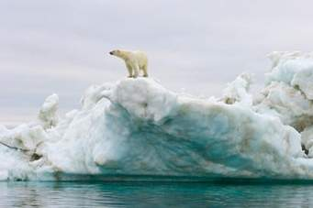
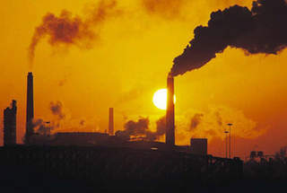
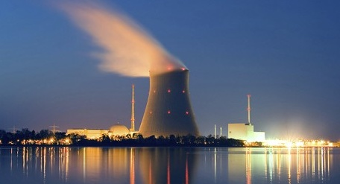
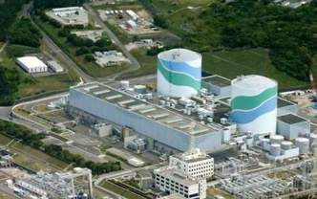

Why talk about uranium?
2

Slide 3

  How safe is uranium and nuclear?
  Can Fukushima happen again?
  Can Australian uranium be diverted to weapons?
  What is the answer to waste disposal?
  How is nuclear part of the world energy mix?
3

Slide 4
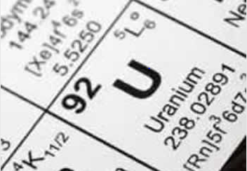
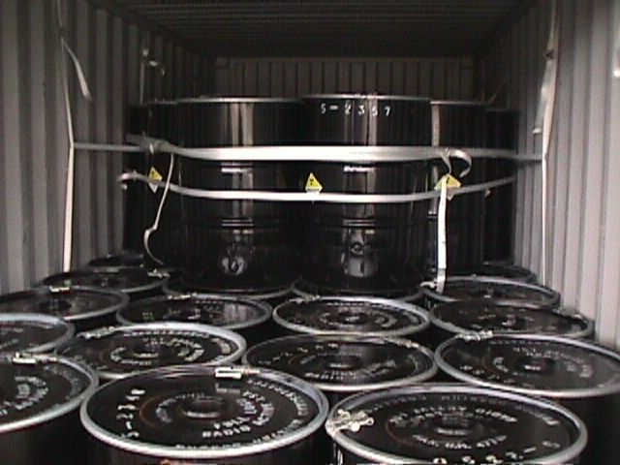
Uranium and Radiation
Uranium and Radiation
Heaviest naturally occurring metal
Mildly radioactive in natural form
3 isotopic forms – ²³⁸U ²³⁵U ²³⁴U
Uranium ore =
  ²³⁸U = 99.3%
  ²³⁵U = 0.7% (fissile)
To convert U ore to nuclear fuel requires multiple processing steps
1 kg U₃O₈ = 20,000 t black coal
Sufficient energy to power an average household
for 25 years
4
Notes:
AI Comments: have included an intro section as I think it’s important to explain Uranium & Radiation to give context and help set the base for later on. Similarly have included exposure pathways & background radiation to help with the explanation on why it is considered
AI Comments 01-Aug: Exposure pathways had an error as it appeared as “Exposure PaCorporate thways”

Slide 5

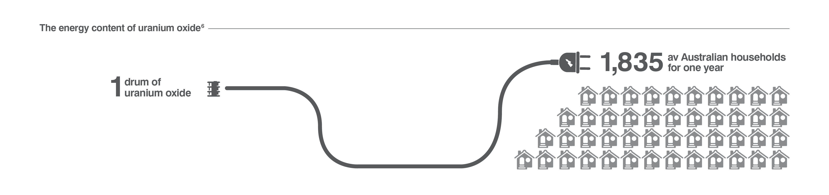
Uranium as a source of energy
=
1 kg uranium
Household for 25 years
22

Slide 6
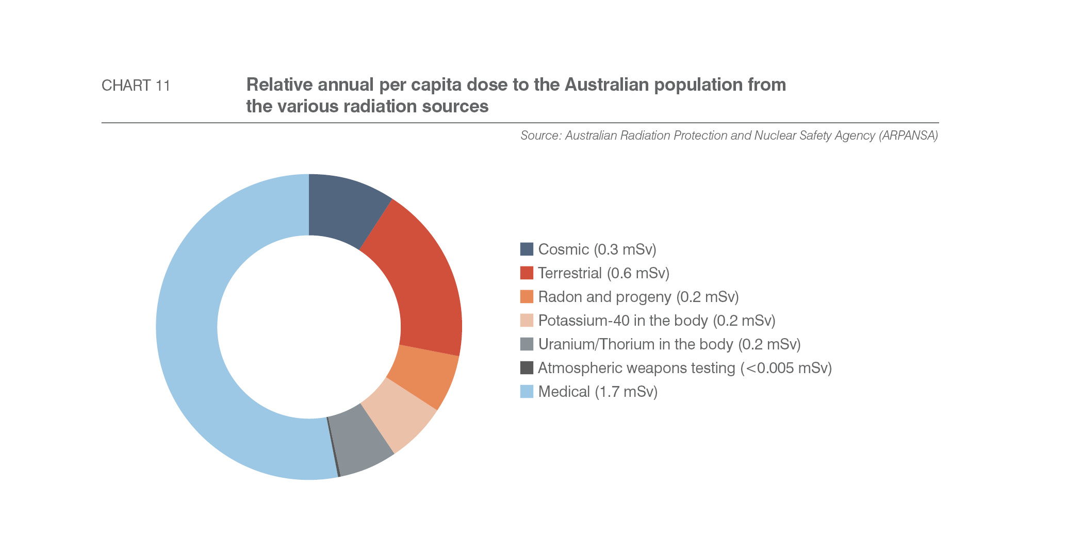
Where does radiation come from?
Total annual per capita dose = 3.2 mSv
5

Slide 7
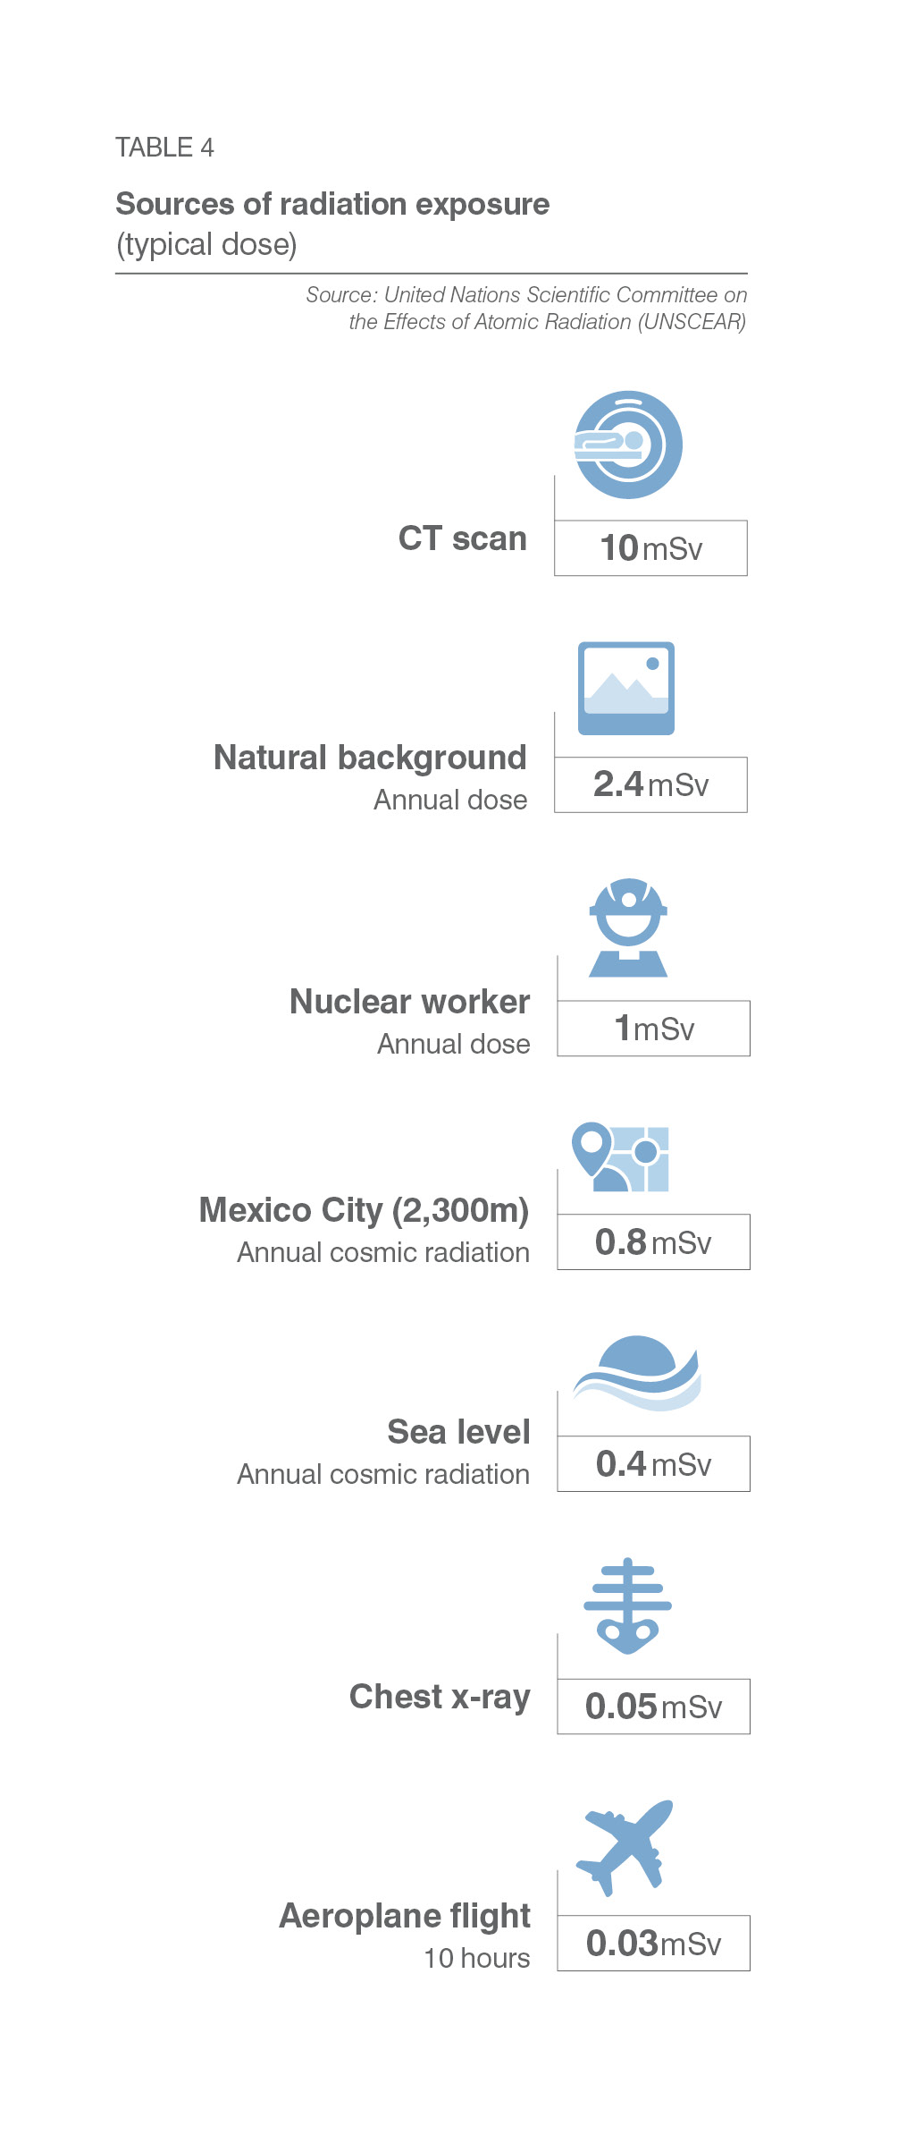

Sources of Radiation Exposure
What most people don’t know about radiation….
6

Slide 8
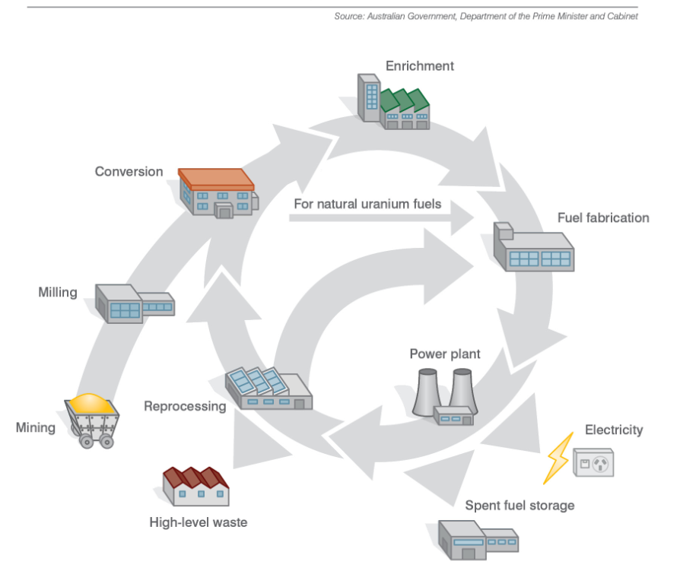
Nuclear Fuel Cycle
9

Slide 9
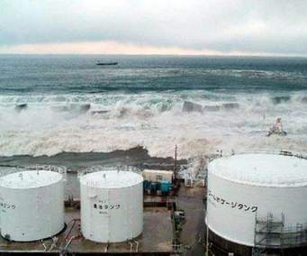
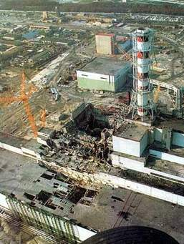
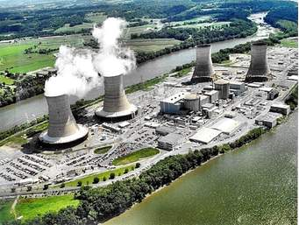
Lessons from Incidents
Three Mile Island
Operator training
“Human” factors
Fukushima
Plant design
Risk Protection
Early warning systems
Useful life
Chernobyl
Plant design
Planned maintenance
“Human” factors
10

Slide 10
Deaths from nuclear related events
75,000
1979
3 Mile Island
2011
Fukushima
4000?
990
64
0
105
2014
WA roads
2014
Commercial airlines
1986
Chernobyl
Source: WA Police, UNSCEAR, IAEA, CNN

Slide 11
Events since Fukushima
Japan systematically closed reactor fleet over 2 year period
Loss of 30% power generating capacity – replaced by oil, coal and gas
Japan committed to 22% nuclear energy as part of future energy mix
2 reactors allowed to re-start – Ohi 1 and Ohi 2 then closed after one year operation
25 reactors re-start applications in place
Sendai 1 reactor re-started 10 August, Sendai 2 reactor now ready
Japanese nuclear operators investing ¥3 trillion in safety measures
China suspended approvals for reactor new builds, now recommenced Gen IV design

Slide 12
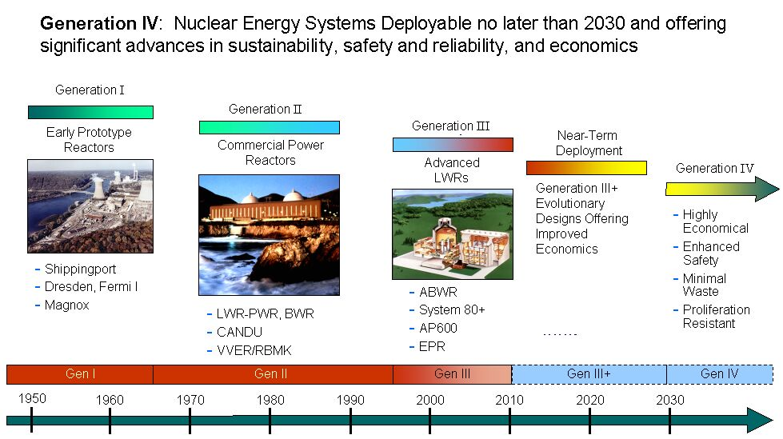
New Reactor Design

Slide 13
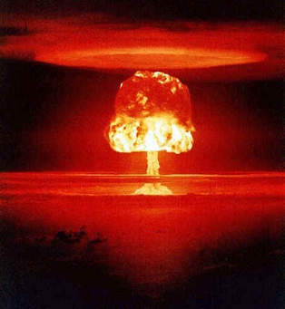
Uranium and Nuclear Weapons
²³⁵U is required at 3-5% for nuclear power generation,
and at >95% for weapons
IAEA safety checks on reactors every 13 months
“Megatons to Megawatts” US-Russia program
  20 years, US$1.3 billion
  500 tonnes weapons grade HEU removed
  7 trillion KWH or 10% US electricity generation
NPT commenced in 1968, now 191 countries have signed
5 recognised nuclear states
  US, Russia, UK, France and China
5 other countries that are non-signatories
  India, Pakistan, South Sudan, Israel and North Korea
Australia-India Nuclear Civil Cooperation Agreement 2014
  Yet to be ratified by Australian Parliament
  Will need to meet Australian Safeguards Act
  Reflects IAEA requirements
Source: WNA

Slide 14
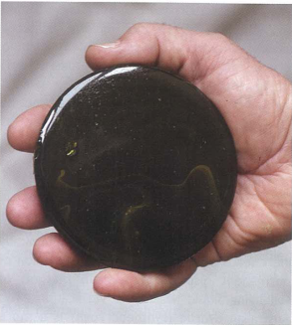
Nuclear Fuel and Waste
Nuclear Fuel and Waste
 |  | Percent by radioactive content | Percent by volume
Low level waste | Hospitals/medical; Industrial, tailings | 1 | 90
Intermediate level waste | Resins, cladding, industrial, construction | 4 | 7
High level waste | Spent fuel, reprocessed waste | 95 | 3
The hockey puck test:
High level spent fuel from one person’s lifetime
Source: WNA
14

Slide 15
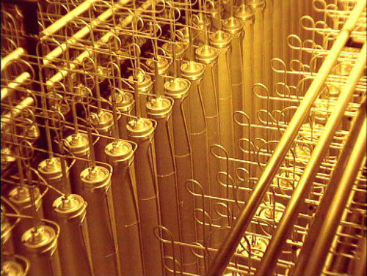
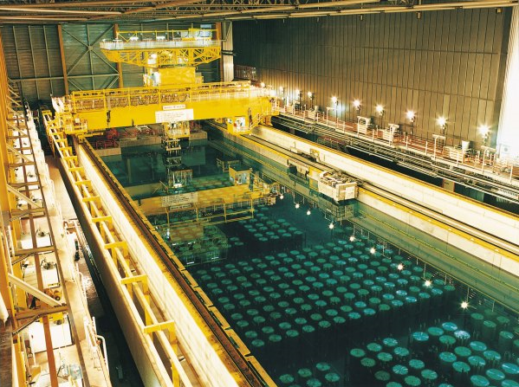
Nuclear Fuel and Waste
The waste dilemma
Technology solutions available today
  Multiple barrier systems
  Geological repositories
Total waste over 60 years = 30,000m³
Equivalent to 10 Olympic swimming pools
By 2040 = 60,000 m³
1GWe reactor = 3m³ (27t) per year of waste
1000 years to decay to original
radioactivity levels
5% total cost of electricity production
Source: WNA
15

Slide 16
  Uranium – critical to a clean energy future
18

Slide 17
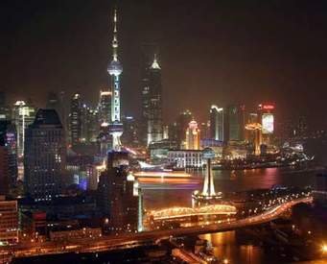
7.3 billion people….
47%
of world’s population
6 out of 10
Have nuclear power
19

Slide 18
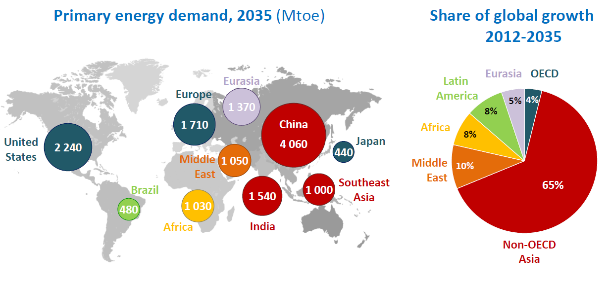
World Energy Outlook 2014
(1)
    (1) Million tonnes oil equivalent (Mtoe)
    (1) Million tonnes oil equivalent (Mtoe)
    Source: IEA 2014
20

Slide 19
Where will the energy come from?
 |  | Increase by 2040 | Percent % increase
Oil supplies | Non-OPEC supplies to 2025 Requires investments in Middle East | 14 mbd | 15
Coal | 70% output from India, Indonesia, China, Australia by 2040 | 6,350 Mtce | 0.5%pa
Gas | Includes unconventional gas 31% increase Requires $11 trillion infrastructure investment | 5,400 bcm | 50
Nuclear | Includes 380 GW added, 148 GW retired | 624 GW | 60
Renewables | Includes hydro, solar, wind, biofuels 33% global power generation by 2040 Requires subsidies of $205 billion in 2040 | 16,500 TWh | 300
CO₂ emissions | 40% of global emissions over the period | 15.4 Gt | 16
    Source: IEA 2014
21

Slide 20
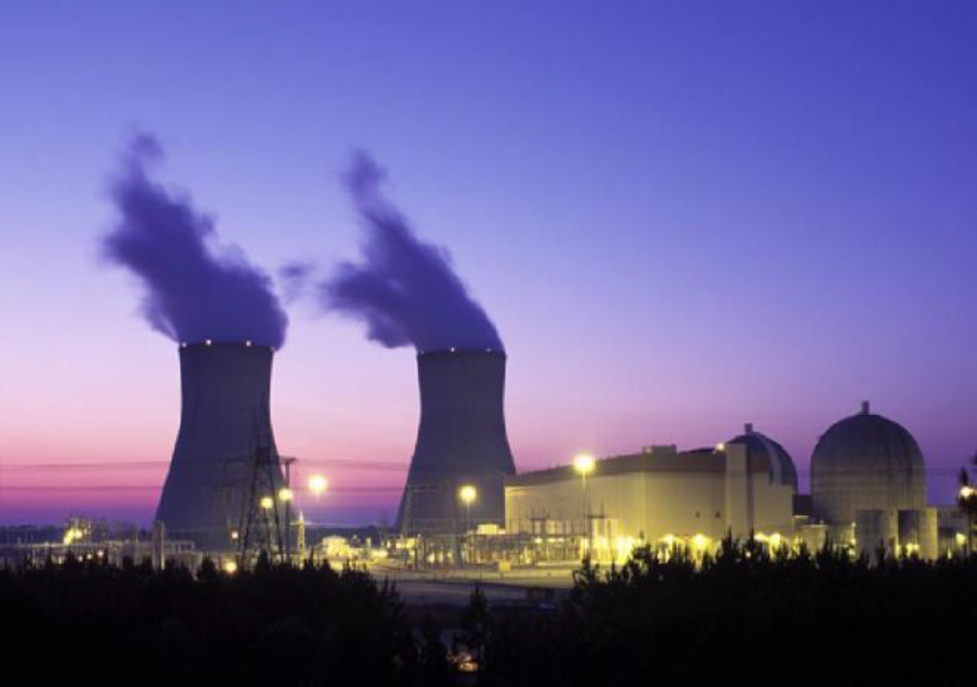
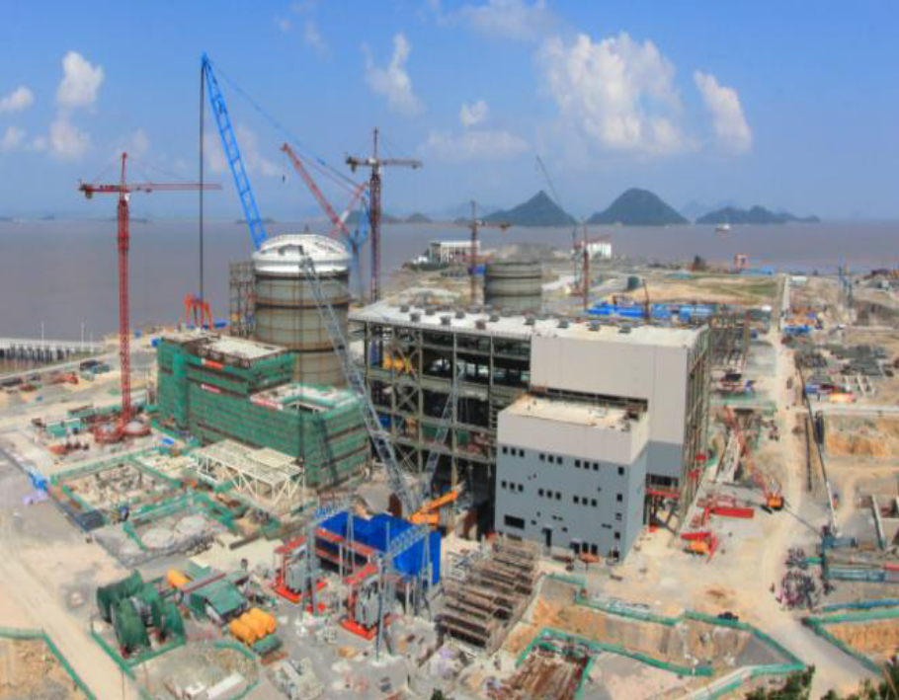
Nuclear Power today
437
69
Operable reactors Under construction
23

Slide 21
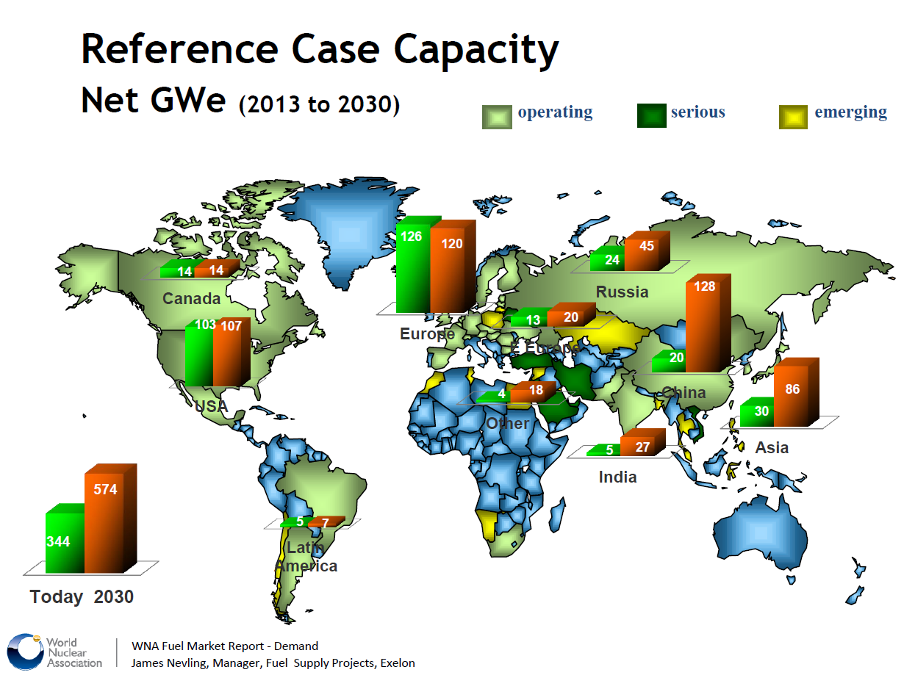
Global Nuclear Power Growth
Uranium Demand
21
Notes:
India numbers from WNA website: http://world-nuclear.org/info/Country-Profiles/Countries-G-N/India/#.UZBmU7X-EQY
Nuclear power supplied 20 billion kWh (3.7%) of India's electricity in 2011 from 4.4 GWe (of 180 GWe total) capacity and after a dip in 2008-09 this is increasing as imported uranium becomes available and new plants come on line.
The target since about 2004 has been for nuclear power to provide 20 GWe by 2020, but in 2007 the Prime Minister referred to this as "modest" and capable of being "doubled with the opening up of international cooperation."

Slide 22
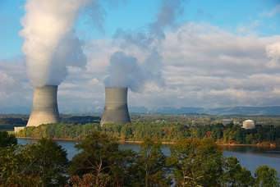
Nuclear Power in 2040
60% ⬆
624GW
380 GW added
148 GW retired
112,000Mt
CO₂ emissions avoided
27

Slide 23
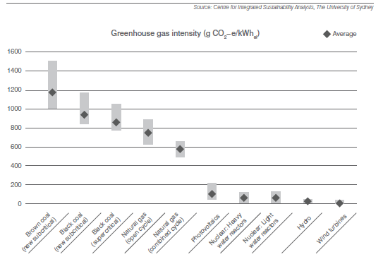
Nuclear Power & Climate Change
Source of low emissions energy
Life cycle emissions in the same range as renewables
Competitive average levelised costs per unit power output ($/MWh)
Recognition by US-China Joint Announcement on Climate Change
Nuclear power generation projected to grow by 60% by 2040
1GWe nuclear reactor could meet Australia’s emissions reductions commitments by displacement of fossil fuels
Life cycle emissions from power generation
    Source: IEA, 2014; MCA 2015
29

Slide 24
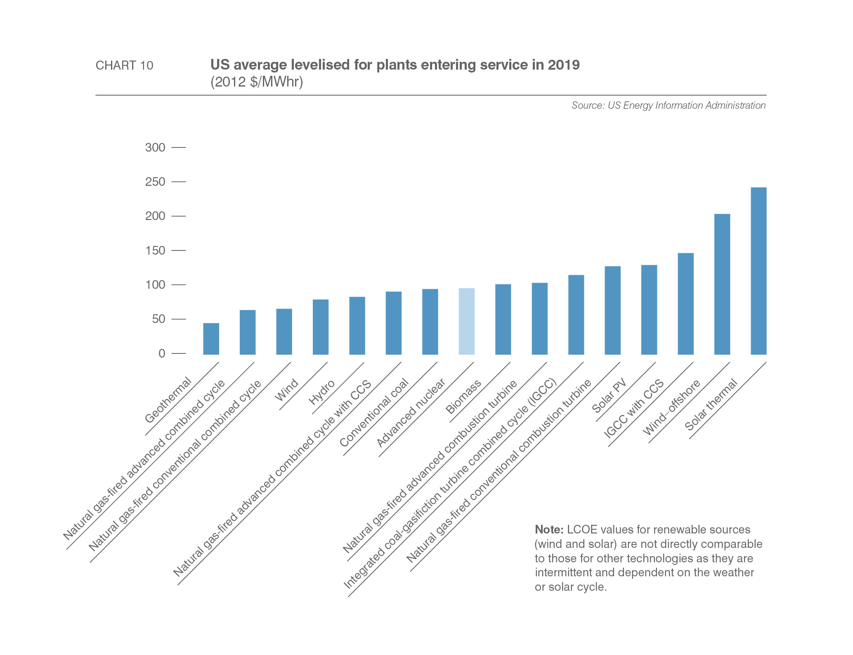
Comparable cost of nuclear power
2012 $/MWhr
28

Slide 25
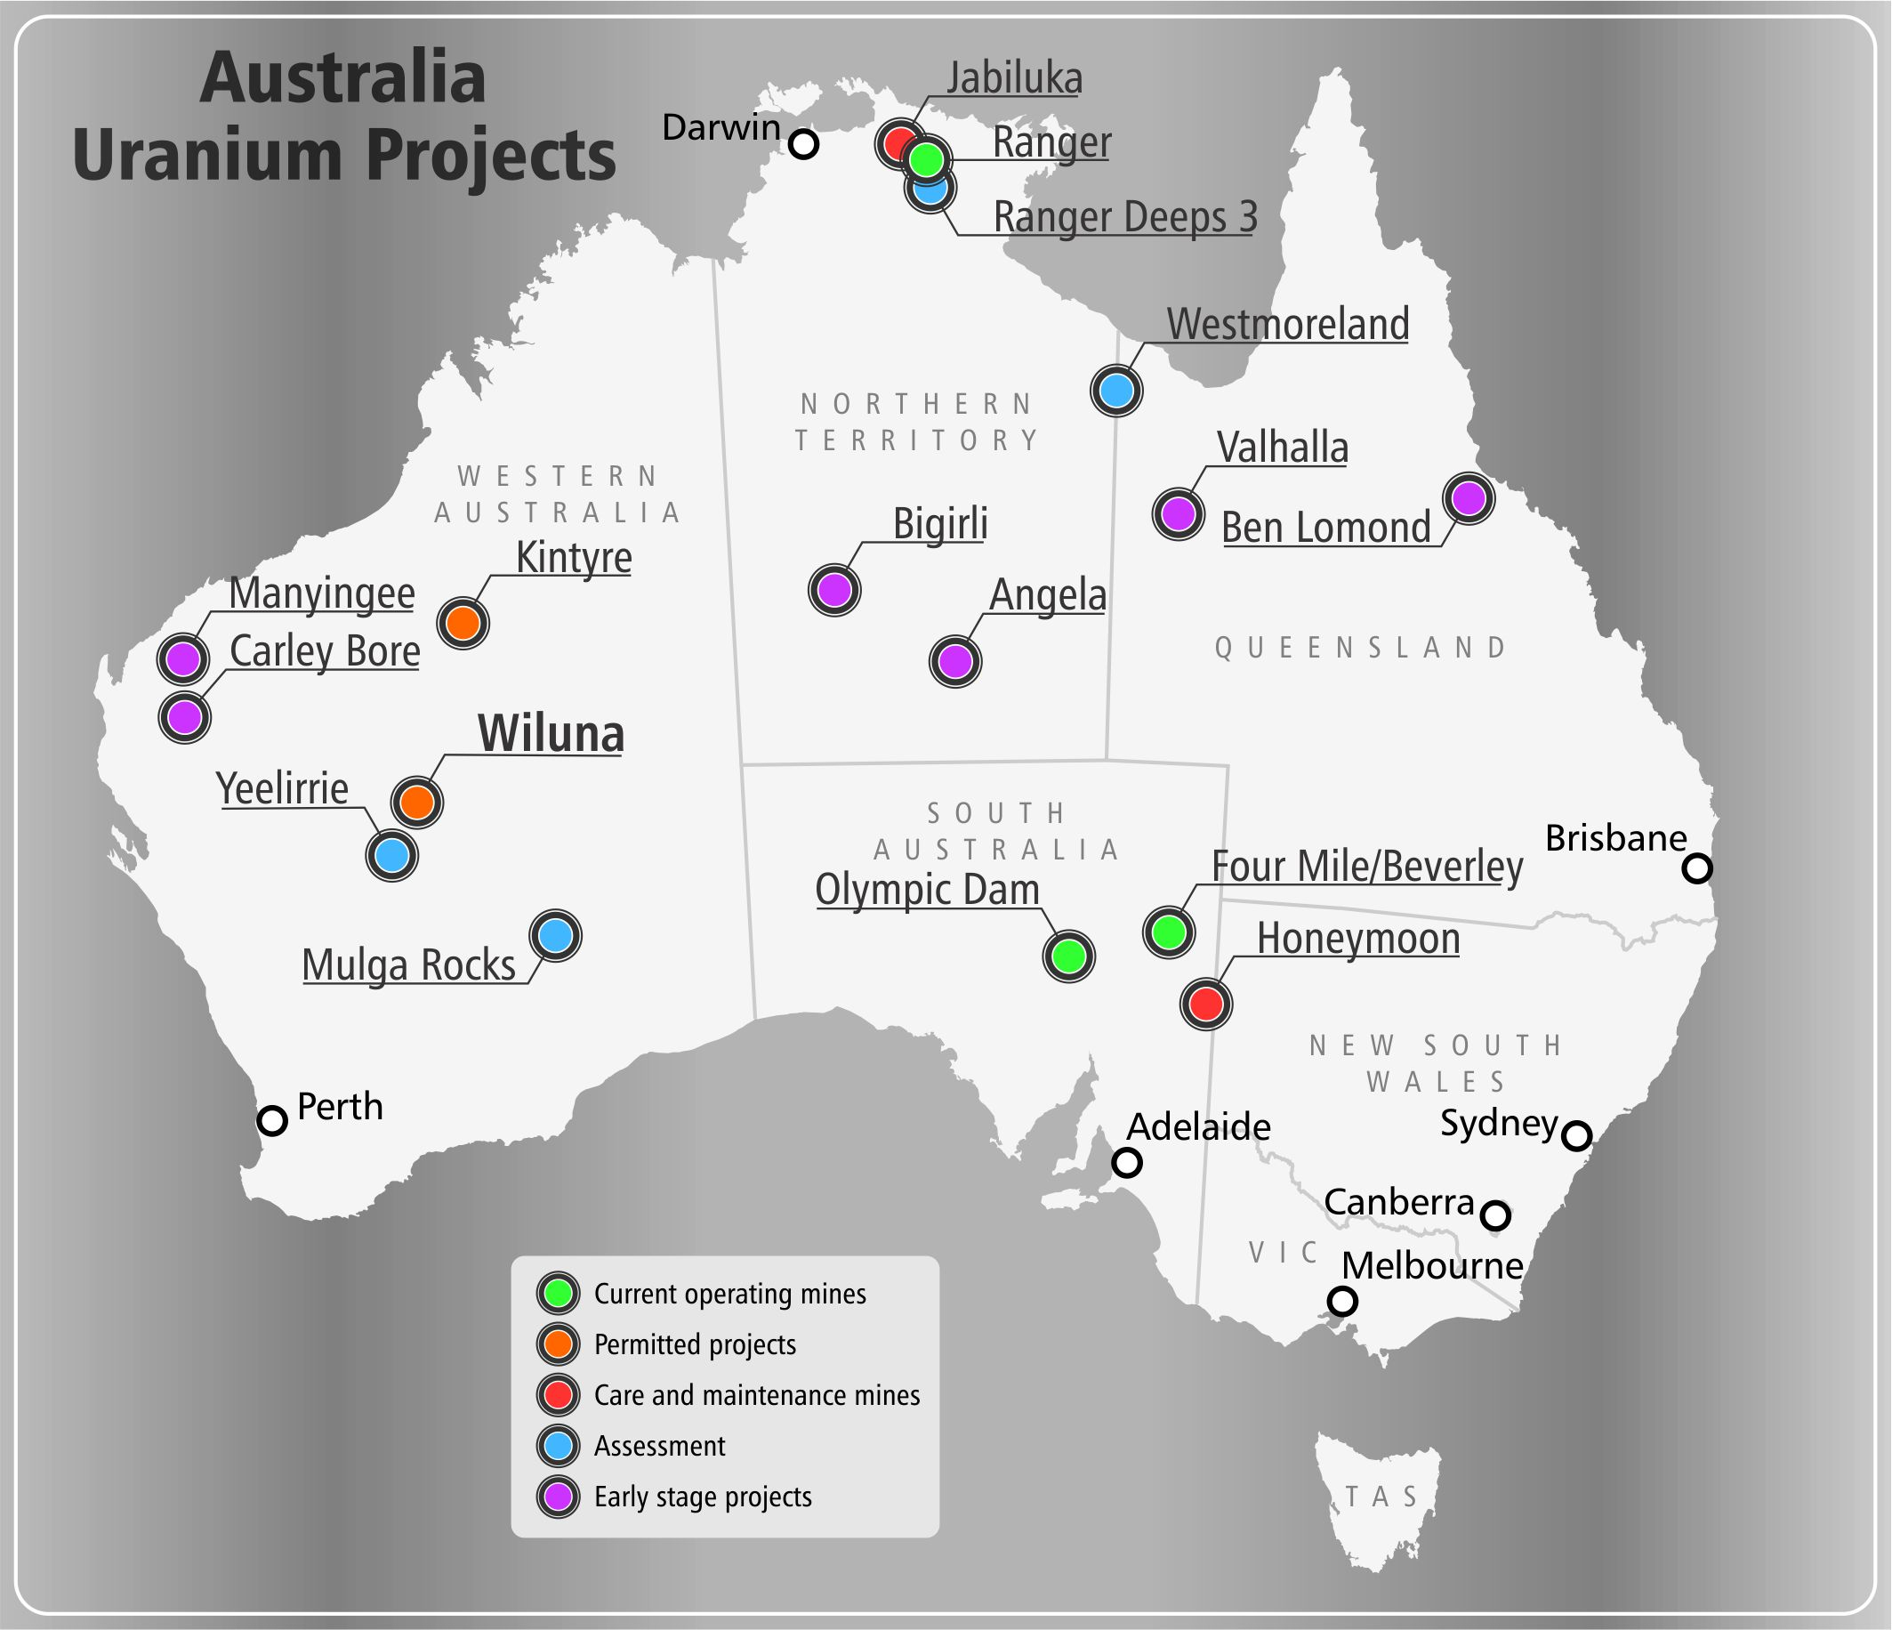
Australia’s contribution…. and potential
Global uranium resources
30
Notes:
1st in resources
32 per cent of global uranium resources
2nd largest primary energy source
22 per cent total primary energy production in 2012/13
3rd in global production
11 per cent of global supply in 2013.
4,200 jobs
Uranium industry employment, much in remote areas
5,710 tonnes
production of uranium in 2013-14
8,900 tonnes
forecast uranium production in 2018-19
$622 million up to $1.1 billion
Australian uranium export earnings in 2013/14
forecast value of Australia’s uranium exports in 2018/19

Slide 26
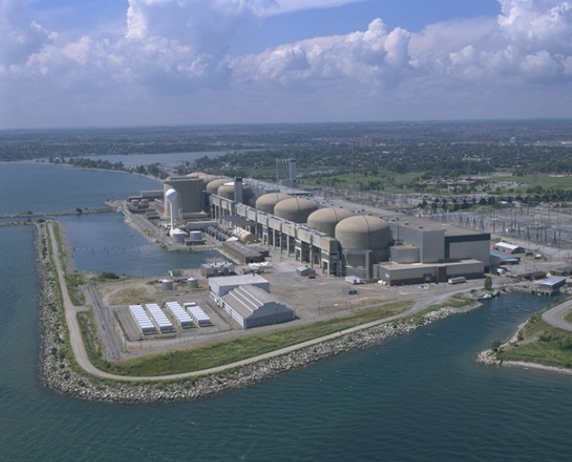
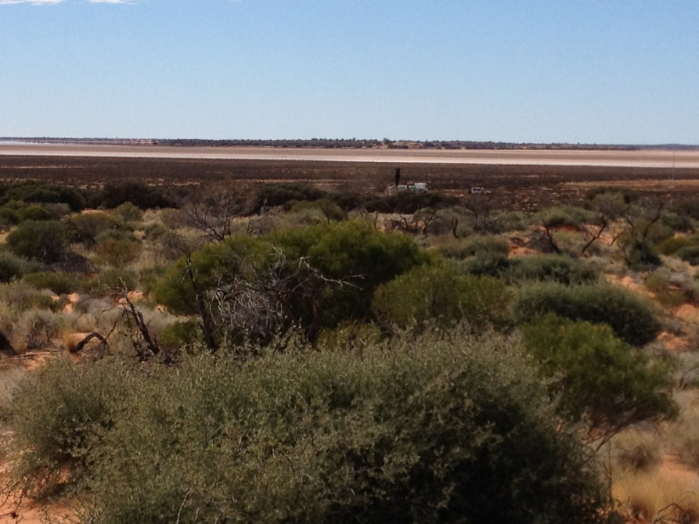
Uranium – critical to a clean energy future
Summary
Uranium and nuclear industry has strong track record
Strong regulatory environment controls safety
International safeguards protect against proliferation
Technical solutions for waste are available now
Nuclear power is important in meeting global energy demand
Nuclear is a natural partner for renewables
Australia = significant U resources, but under-represented as a global supplier
Wiluna Project = an opportunity for WA
Notes:
AI Comments: have included an intro section as I think it’s important to explain Uranium & Radiation to give context and help set the base for later on. Similarly have included exposure pathways & background radiation to help with the explanation on why it is considered
AI Comments 01-Aug: Exposure pathways had an error as it appeared as “Exposure PaCorporate thways”

Slide 27
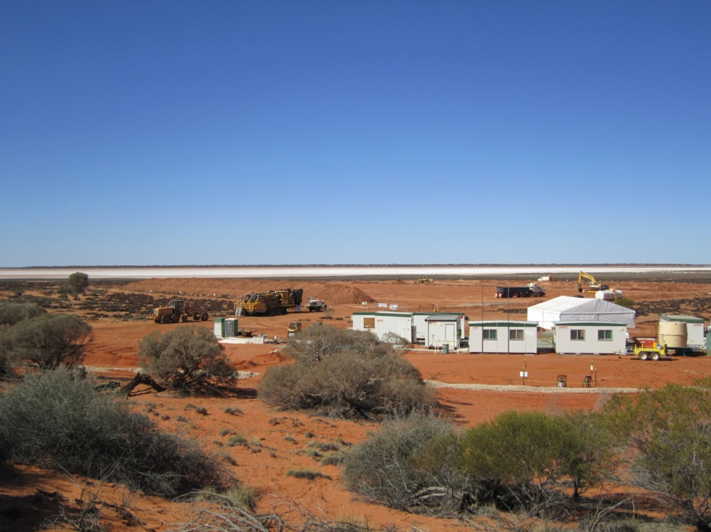
Thank you
Contact
Dr Vanessa Guthrie
Managing Director
Toro Energy Limited
L3 33 Richardson street
WEST PERTH WA 6005
Telephone: +61 8 9214 2100
Email: info@toroenergy.com.au
Website: www.toroenergy.com.au

